Slide 1
GROWING VIDEO GAME SALES
an analysis on
video game sales

Slide 2
IN 2026, PLAYING VIDEO GAMES IS A POPULARISED
PAST-TIME HOBBY AND A CAREER
with
3.32b
gamers world-wide in 2026¹
including
10.84m
gamers in
the UK alone ²
and this is forecasted to increase by 6.67% by 2027!
¹ Source: Exploding Topics Survey
² Source: Statista Survey

Slide 3
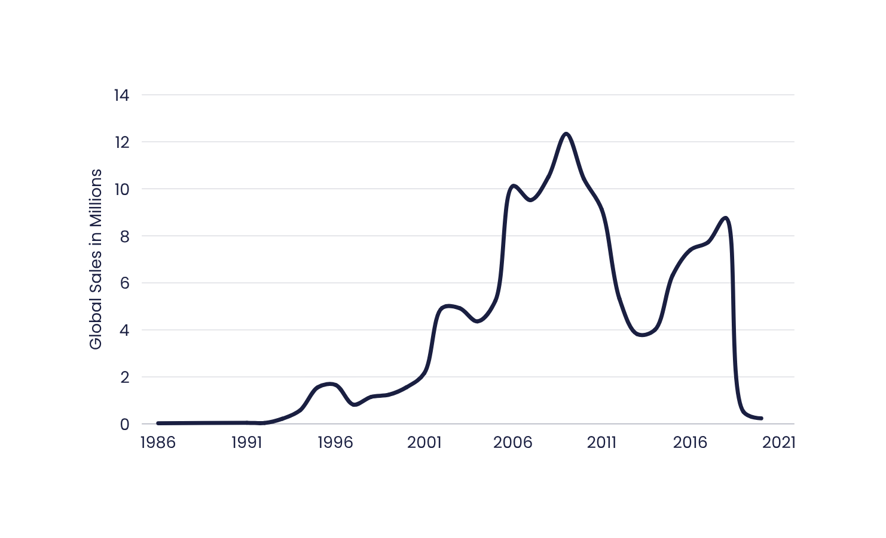
AND VIDEO GAME SALES ARE ONLY GOING TO CONTINUE RISING
12.34
figures impacted by data lag
PS1 & Nintendo 64 release
PS2, Gamecube & Xbox release
PS3 & Nintendo Wii release
Xbox One & PS4 release
COVID-19 pandemic & stock shortages

Slide 4
WHOA, HOLD ON. LET’S TALK ABOUT THAT DATA DROP
After 2018, there’s a huge drop in global sales, so what happened?
DATA LATENCY
COVID-19 PANDEMIC
This is likely the case as the data scrapes a specific website and is reliant on it being accurate and updated.
Because of this, we have limited information available for 2019 and 2020.
In 2019-2020, the world was rocked by the COVID-19 pandemic.
Due to factory closures during the lockdowns, there were shortages in key parts for console production which impacted overall console and game sales.

Slide 5

DESPITE THE DATA, WE KNOW SALES WILL GROW
We’ve already seen that video game sales increase after every major console release. Here’s a few examples:
1995-1996: Playstation 1 and Nintendo 64 release
2000-2001: Playstation 2, Xbox, Gamecube release
2005-2006: Xbox 360, Nintendo Wii & Playstation 3 release
2012-2014: Wii U, Xbox One & Playstation 4 release

Slide 6

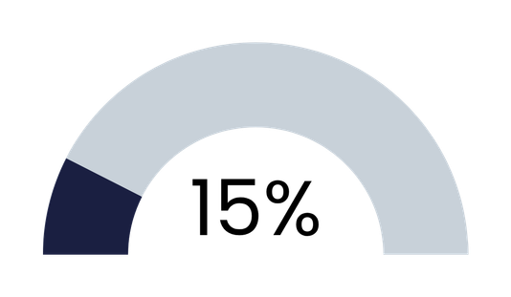
GAMERS LIKE TO BE TAKEN ON AN ADVENTURE
of total global sales are from adventure games
Adventure games have the highest number of games within the gaming industry and it’s no surprise why.

Slide 7
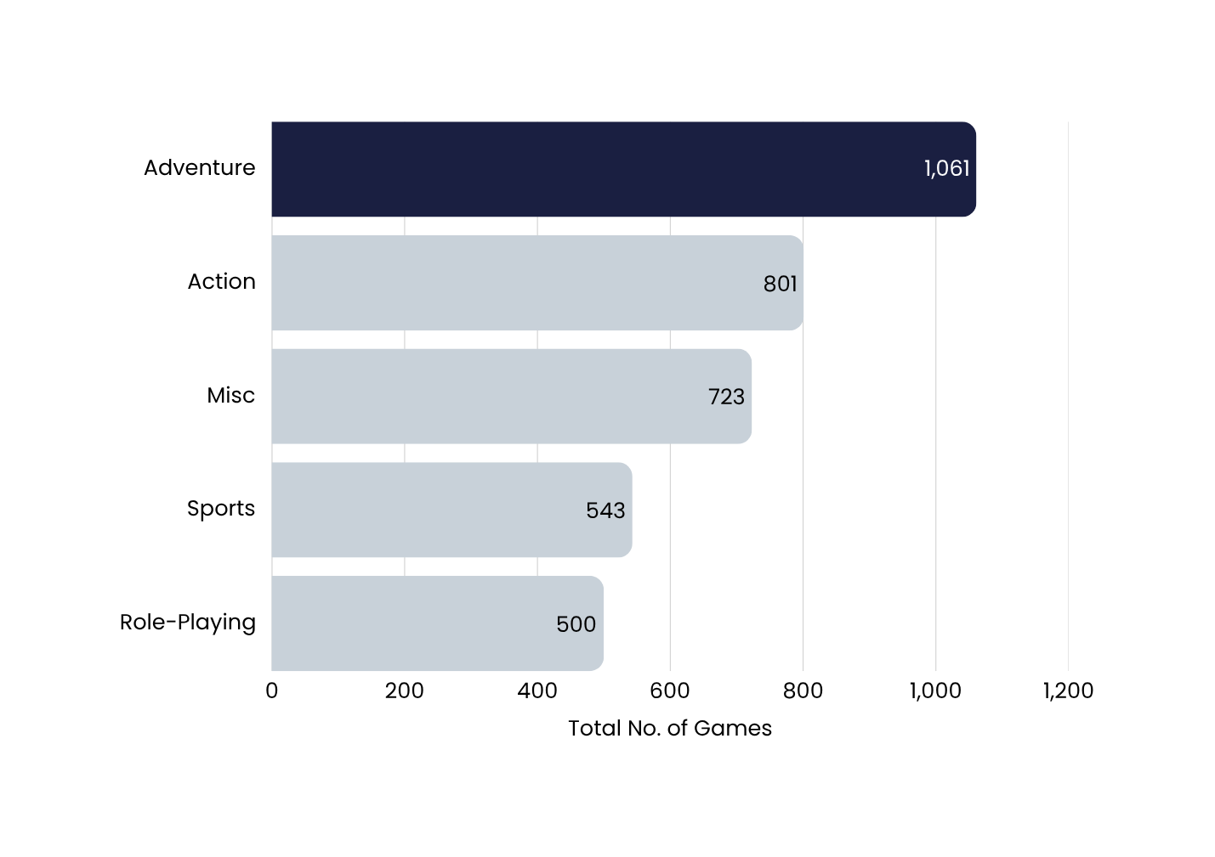
ADVENTURE DOMINATES THE MARKET
17%
of all games are adventure games

Slide 8
IS ADVENTURE AN EXHAUSTED OPTION? NO!
Adventure games might have the most games, but they still continually perform well in comparison to the next highest genres.
Adventure
Action
Misc.
1.46m
average global sales between 2008-2018
1.04m
average global sales between 2008-2018
0.8m
average global sales between 2008-2018

Slide 9

AFTER ALL, ISN’T FINDING A NEW ADVENTURE WHAT GAMES ARE ABOUT?
Games allow consumers to whisk away from the constraints of reality - whether that’s home life, studying or work stress. It gives them a chance to explore new worlds all from the freedom of their favourite comfortable seat.

Slide 10
OUR FOCUS SHOULD ALWAYS BE THE HORIZON
Upcoming technology
Adventurous story-telling
Research new technology & consoles for game development
Developing new games that take customers on an adventure

Slide 11

LET’S MAKE GAMES
AN UNFORGETTABLE ADVENTURE

